Slide 1
Employee Data Analysis using Excel
STUDENT NAME: DEVAMUTHARASU P
REGISTER NO: 122203377
ABA2BC4A5C4A3F5B3F843E954DA42D2D
DEPARTMENT: B COM [CS]
COLLEGE: ST. THOMAS COLLEGE OF ARTS AND SCIENCE

Slide 2
PROJECT TITLE
Employee Attrition Analysis using Excel Dashboards

Slide 3


AGENDA
Problem Statement
Project Overview
End Users
Our Solution and Proposition
Dataset Description
Modelling Approach
Results and Discussion
Conclusion
3/21/2024 Annual Review

Slide 4


PROBLEM STATEMENT
Employee Attrition Analysis Using Excel Dashboards involves evaluating and measuring the Employee’s attrition which affects the business working based on the attrition data (AD). This data is then analysed using excel’s functions and tools, such as pivot tables, charts, and conditional formatting, to identify patterns, and areas for improvement. The analysis help in making informed decisions regarding as to reason for attrition.

Slide 5


PROJECT OVERVIEW
The project “Employee Attrition Analysis Using Excel Dashboards” aims to systematically evaluate employee attrition by leveraging Excel’s analytical tools. The project will involve collecting and organizing employee attrition data such as for the reason he left (Temporary ,Full Time, Part Time). This data will be processed and analyzed using Excel function like pivot tables, charts and statistical formulas to generate Employee Attrition Analysis. The outcome will help in identifying the employee who left the workplace. The final deliverable will include a detailed report and visual dashboards for easy interpretation and strategic planning.

Slide 6
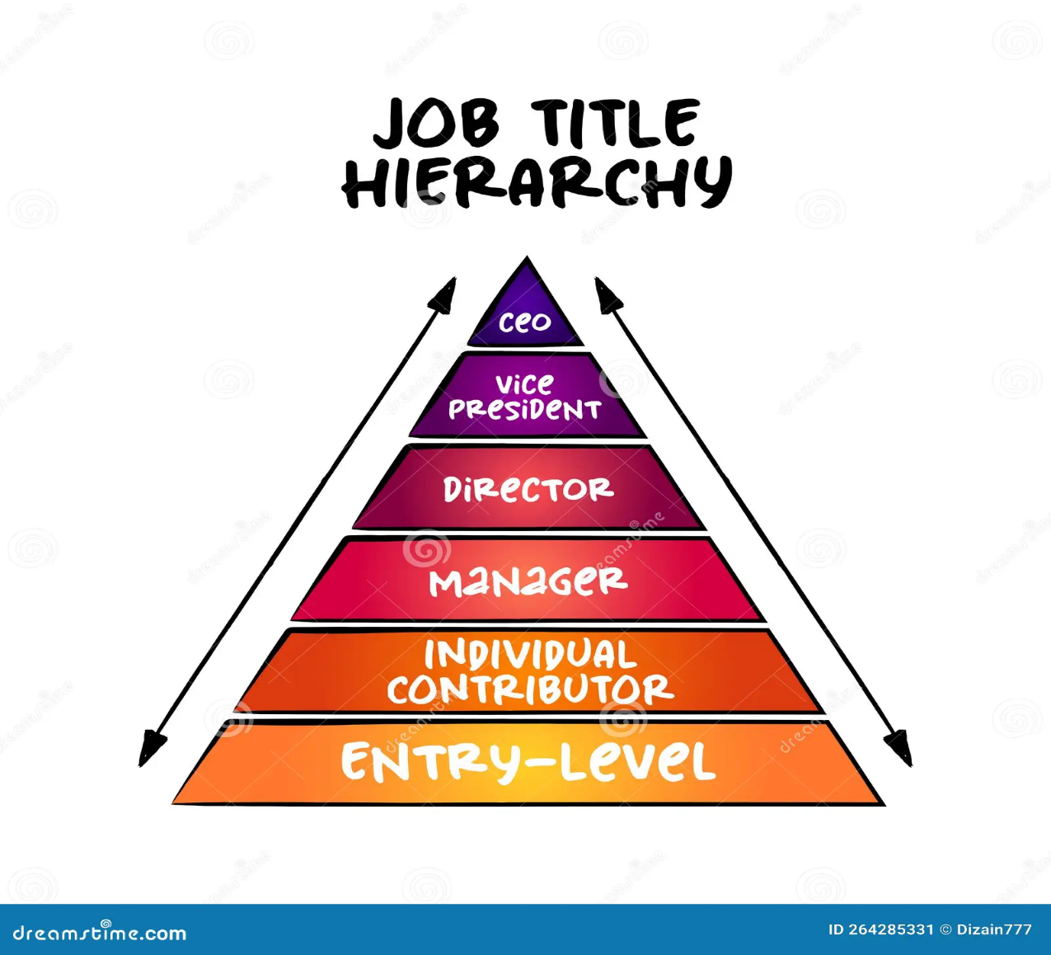

WHO ARE THE END USERS?
Human Resources (HR) Managers:
Department managers/Supervisors:
Senior Management/Executives:
Employees:

Slide 7

OUR SOLUTION AND ITS VALUE PROPOSITION
Data-Driven Insights: Enables managers to make informed decisions based on accurate, real-time attrition data.
Improved Efficiency: Automates the data collection and analysis process, saving time and reducing manual errors.
Enhanced Employee Development: Identifies training needs and development opportunities, leading to a more skilled workforce.
Better Attrition Management: - Regular feedback and coaching, Career development and growth opportunities, - Competitive compensation and benefits.
Cost-Effective Solution: Leverages the widely accessible Excel platform, avoiding the need for expensive software or tools.

Slide 8
Dataset Description
Descriptions for each of the columns in the dataset:
Employees ID: Unique identifier for each employee in the organization
First Name: The first name of the employee.
Last Name: The last name of the employee,
Start Date: The date under which the employee starts working at the company.
Employee Status: This defines whether the employee is currently working in the Co. or future start.
Employee Type: Under what condition did the employee join the company.
Employee Classification Type: under what basis the employee works under the company.
Department Type: under which sub-divided part is the employee part of the company.
Gender Code: segregates employees under male or female.
Notes:
Co. :- company

Slide 9

THE "WOW" IN OUR SOLUTION
Predictive analytics: Integrating predictive methods to forecast future
Attrition trends based on historical data, giving managers a proactive
Approach to workplace planning.
Automated alerts: the tool can be set up to send automated alerts for
critical attrition issues, ensuring that managers are immediately notified
when attention is needed.
3/21/2024 Annual Review
9

Slide 10
MODELLING
In the " Employee Attrition Analysis Using Excel Dashboards " project, the modelling phase involves setting up the Excel workbook with various tools and techniques to analyse and visualize the data effectively.
Here's how each component will be used:
Data Filtering:
Purpose: To sort and refine the data to focus on specific criteria, such as department, date range, or individual employee classifications.
Implementation: Excel's filtering feature will be applied to datasets, allowing users to easily narrow down the data to view only the relevant information. For example, filtering by department or by employees status.
Pivot:
Tables Purpose: To summarize and analyse large datasets by grouping and aggregating data based on different attendance records.
Implementation: Pivot tables will be used to dynamically calculate and display key Employee Types (KETs) such as loss on attrition, total hours worked, voluntary or involuntary . This will allow users to view performance metrics by different categories, like employee, team, or month.
10

Slide 11
RESULTS
11

Slide 12
conclusion
The " Employee Attrition Analysis Using Excel Dashboards " project provides a robust and user- friendly solution for evaluating and managing employee Attrition. By leveraging Excel's powerful tools such as filtering, pivot tables, charts, and conditional formatting-the project transforms raw Attrition data into actionable insights. The resulting interactive dashboards and customizable reports empower managers to make data driven decisions, optimize workforce productivity, and foster continuous improvement across the organization. This solution not only streamlines Attrition management but also offers a cost-effective, scalable approach to enhancing overall organizational efficiency..

